Slide 1
Quantum Chemistry and Quantum Computing
Jacek Jakowski
Oak Ridge National Laboratory

Slide 2
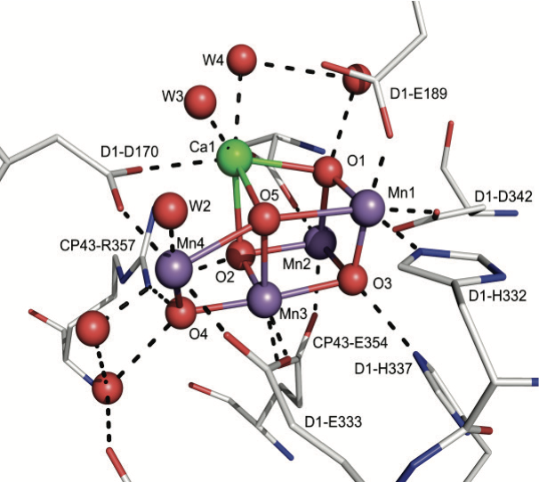
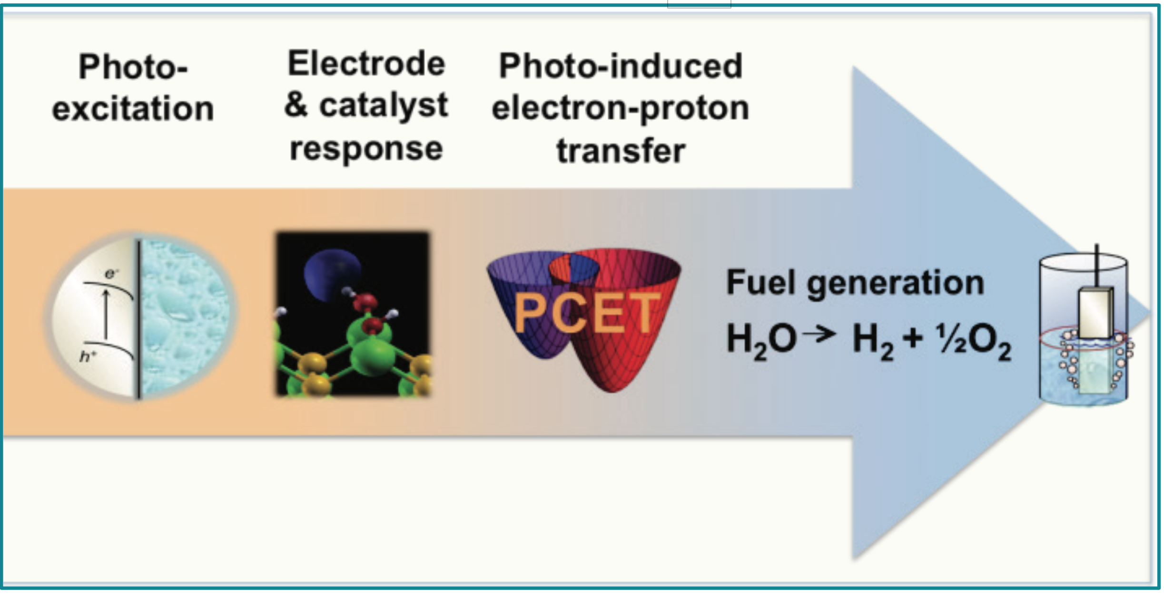
Quantum Computing: Opportunities in Chemical and Materials Sciences
Controlling the Quantum Dynamics of Nonequilibrium Chemical and Materials Systems
Embedding Quantum Hardware in Classical Frameworks
Water-splitting reaction on a catalytic surface:
harvesting light energy to form charge carriers
proton-coupled electron transfer (PCET) processes
multiple pathways, and excited states
time-dependent Schrödinger equation (non-adiabatic)
unfeasible with classical computers.
Enzymatic center of P450 cytochrome
Hybrid model and computing
Separation of problem between “easy” and “hard” part
Interfacing
Ref. BES Roundtable report “Opportunities in Chemical in Materials Sciences, 2017
Mastering the guiding principles that underlie catalytic chemical reactions is crucial to our transition to a more sustainable economy. Indeed, catalysis represents an essential component
in the production of most chemicals and
fuels, with different catalysts functioning to enable diverse chemical tasks ranging from the splitting of water and nitrogen fixation to the selective transformation of complex molecules for pharmaceutical synthesis.5 Despite its importance and ubiquity, predicting catalytic reactions using computer simulations remains an open challenge, encompassing outstanding problems such as the simulation of chemical reactions in condensed phases, the importance of nonadiabatic phenomena, and the characterization of pathways often involving (multiple) electronic excitations
Notes:
LEFT: Mastering the guiding principles that underlie catalytic chemical reactions is crucial to our transition to a more sustainable economy. Indeed, catalysis represents an essential component in the production of most chemicals and fuels, with different catalysts functioning to enable diverse chemical tasks ranging from the splitting of water and nitrogen fixation to the selective transformation of complex molecules for pharmaceutical synthesis. (5) Despite its importance and ubiquity, predicting catalytic reactions using computer simulations remains an open challenge, encompassing outstanding problems such as the simulation of chemical reactions in condensed phases, the importance of nonadiabatic phenomena, and the characterization of pathways often involving (multiple) electronic excitations
We call these electronic structure challenge problems that are defined by the failure of classical approximate methods. This means that (1) they must exhibit large correlation energy so that self-consistent field approaches fail; (2) they must exhibit a severe fermion sign problem so that QMC fails; and (3) coupled-cluster or similar gold standard correlation approaches must not yield the desired accuracy. In addition, they must present a sufficiently severe multi-reference character to confound full configuration interaction QMC approaches. Clearly, these conditions mean that small example problems will be few in number, and the best classical approaches may require high-accuracy solutions. A bridging approach uses the best classical results as the starting point for a quantum variational method. The quantum resources are used to broaden the space of possible ansatz states available to the variational method and can therefore improve upon the best classical approach.

Slide 3
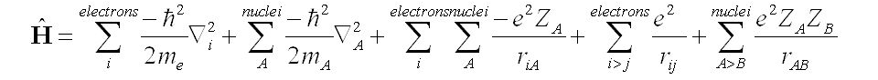
Variational Methods
Variational principle → find quantum state by minimization of energy:
Hamiltonian for a Molecule
kinetic energy of the electrons
kinetic energy of the nuclei
electrostatic interaction betnwen electrons and nuclei
electrostatic interaction between electrons
electrostatic interaction between nuclei
Trial function (ansatz)

Slide 4
Variational Methods
Variational principle → find quantum state by minimization of energy:
Trial function (ansatz):
← Linear combination of basis functions
← Unknown parameters (to be changed)
← Fixed basis set ( NOT to be changed)
← Overlap matrix
← Orthonormality of basis set (=orthogonal, normalized)
Normalization of requirement:
Rotation of the N-dimensional sphere
of radius =1
Trial function (ansatz)

Slide 5
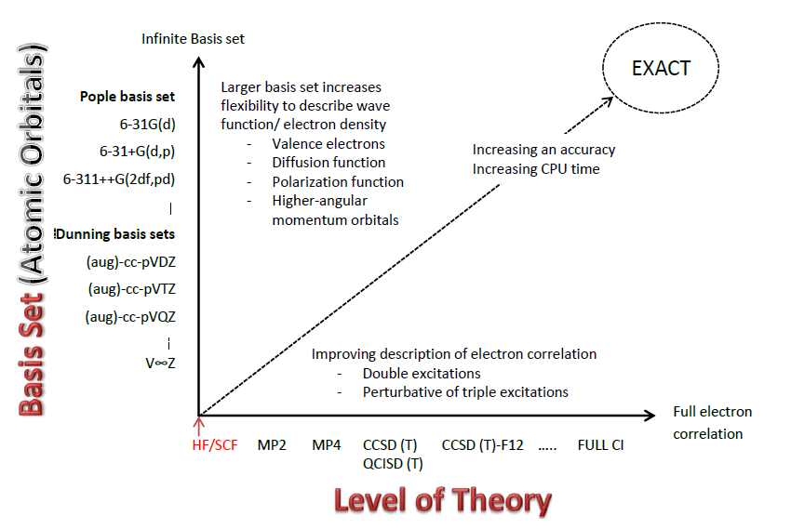
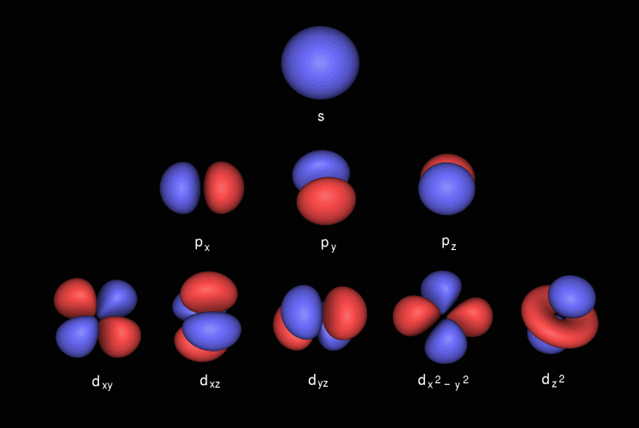
Quantum chemistry hierarchy: Pople diagram
Relation between basis set and levels of theory typically used in quantum chemistry.
Basis set:
Atomic Orbitals
(AO)
https://en.wikipedia.org/wiki/Pople_diagram
Notes:
https://medium.com/@jackkrupansky/the-greatest-challenges-for-quantum-computing-are-hardware-and-algorithms-c61061fa1210
Very few of us today have had the experience of programming on a bare machine with no supporting software and no wealth of literature to consult for algorithms and approaches to solving problems. Granted, we do have embedded computers and microcontrollers, such as the Arduino, where you are running on bare hardware with minimal software, but even then we are still able to exploit the deep knowledge of traditional digital computing, including data types, data structures, control structures, high-level programming languages, and a wealth of existing algorithms, methods, and techniques, none of which exist at present for quantum computers.
For classical computing, the concept of assembly language or machine language at the level of discrete machine language instructions, bits and bytes, and constantly worrying about an extremely strict limit on memory and how data is arranged is a thing of the past, but for quantum computing these and other related factors remain front and center and are severely slowing if not outright blocking any rapid progress.

Slide 6
Quantum chemistry hierarchy
Mean field methods
- Hartree-Fock (HF), Density Functional theory (DFT)
- independent particle model → uncorrelated particles in the average field
Many-body methods:
post Hartree-Fock methods→
perturbational methods (MP), coupled cluster (CC), configuration interaction (CI), - dynamical correlation between electrons

Slide 7
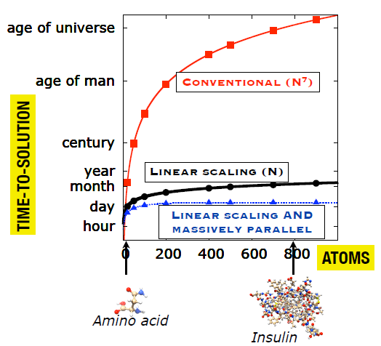
Computational scaling and cost
Scaling: O(N⁷)
Example:
Double the size 2⁷=128
1h → 5 days
5 days→ 2 years
Coupled Cluster theory

Slide 8
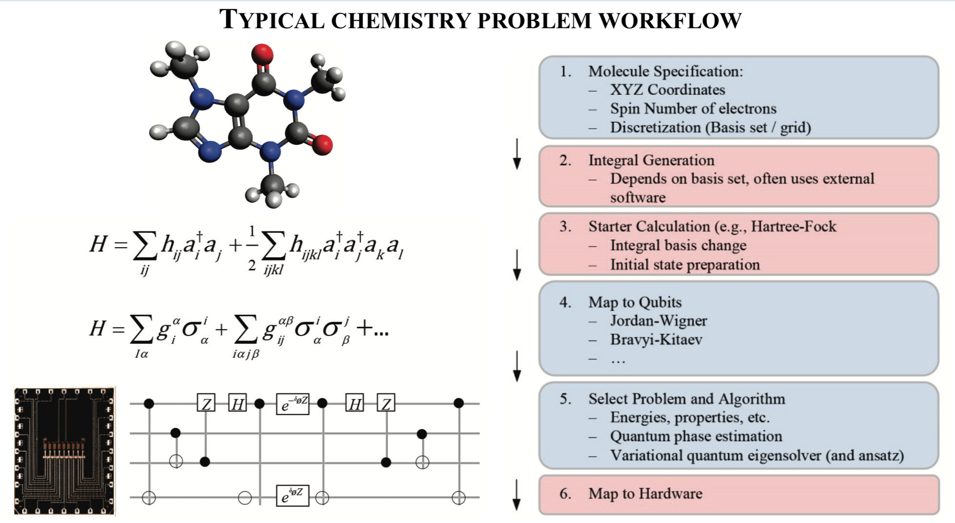
Mapping a Chemistry Problem onto a Quantum Computer
Ref. BES Roundtable report “Opportunities in Chemical in Materials Sciences, 2017

Slide 9
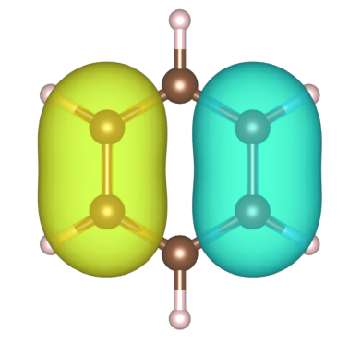
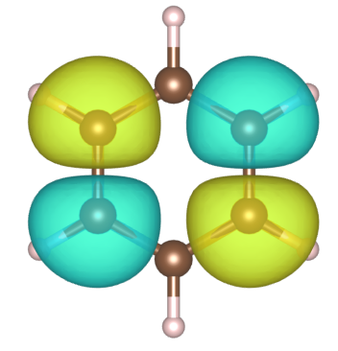
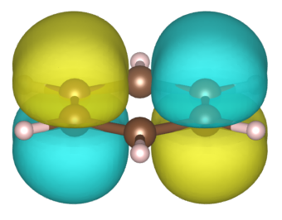
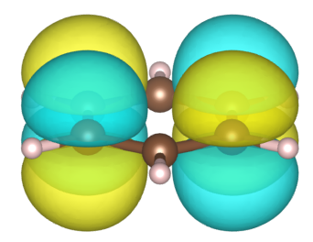
Variational Method
Hartree Fock (HF) or DFT: →find 1-electron wavefunctions in the field of N-1 electrons and M nuclei
→ mean field method solved iteratively
Atomic Orbitals (AO)
Benzene
Molecular Orbitals (MO)
→ HF results are used to form 2nd quantization Hamiltonian
MO-1 :

Slide 10
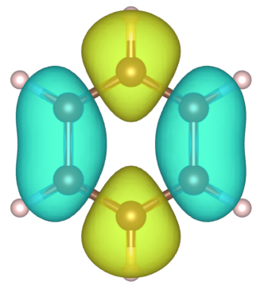
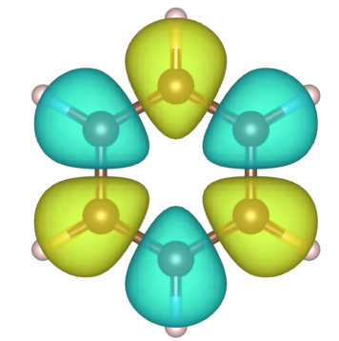
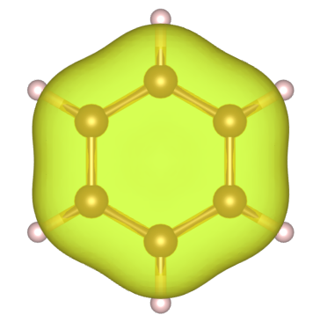
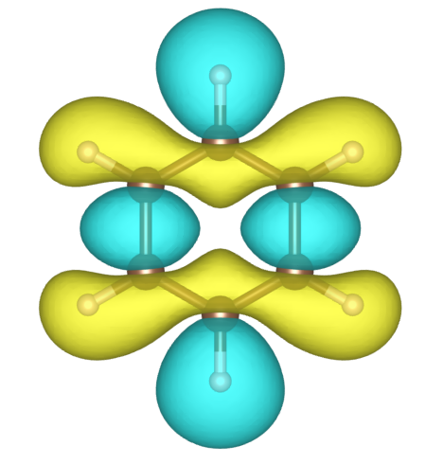
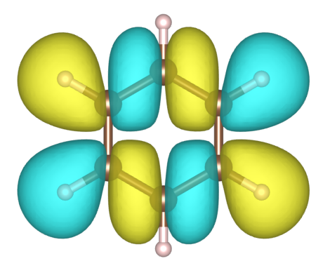
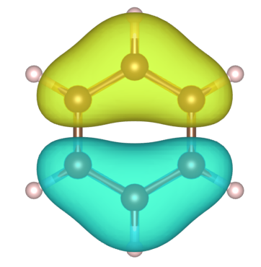
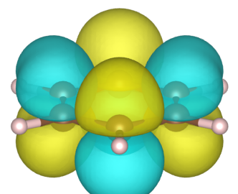
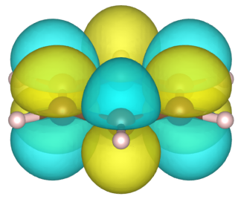
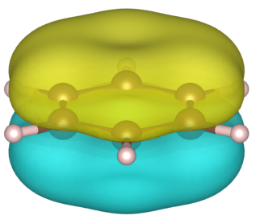
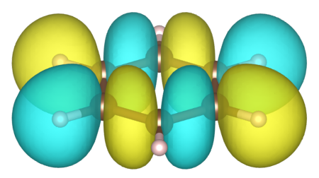
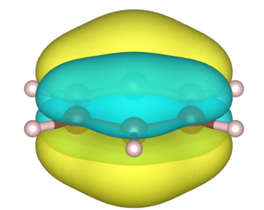
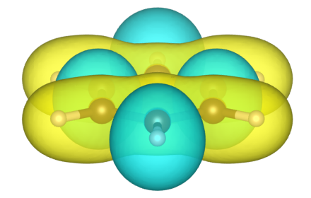
Benzene
12 atoms: C₆H₆
electrons:
36 basis functions / 72 spinorbitals (STO-3G set)
19
Fermi level
#
17
18
20
21
22
23
24
occupied virtual
Orbital Energy

Slide 11
Mapping a Chemistry Problem onto a Quantum Computer
Ref. BES Roundtable report “Opportunities in Chemical in Materials Sciences, 2017

Slide 12
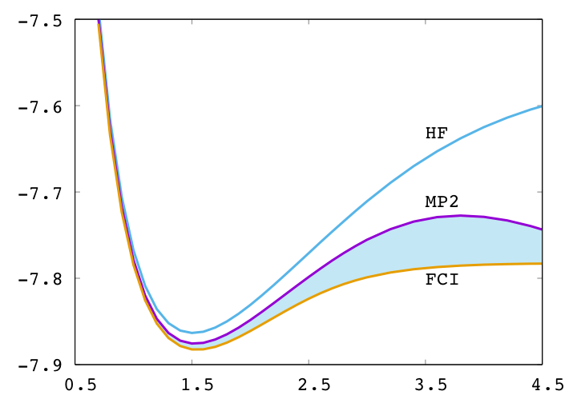
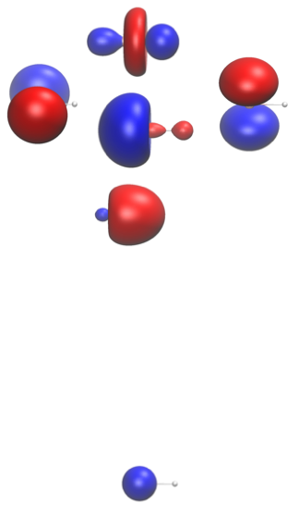
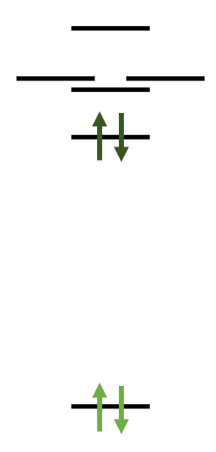
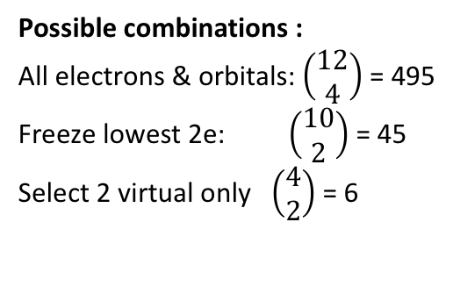
Example: LiH, STO-3G basis set
LiH model:
4 electrons
6 orbitals
12 spinorbitals
Li
H
excitations
Separation (Angstroom)
Possible combinations :
All electrons & orbitals: $\left(\begin{matrix}12 \\ 4\end{matrix}\right)$ = 495
Freeze lowest 2e: $\left(\begin{matrix}10 \\ 2\end{matrix}\right)$ = 45
Select 2 virtual only $\left(\begin{matrix}4 \\ 2\end{matrix}\right)$ = 6
Energy

Slide 13
Example: 2 particles in 4 states
Quantum Advantage and Quantum Chemistry
Many-Body problem
Hartree-Fock state
0
Many-body basis states
3
1
4
Hilbert space:
N- available states
(1-particle)
2 -occcupations = {0,1}
Space size: 2^{N}
(from 0 to N-particles)
2
5
Correlated wave function:
linear combination of basis states
Solve for b’s by diagonalizing the Hamiltonian matrix
Source: David Dean (ORNL)

Slide 14
General many-body problem for fermions (Hilbert spaces)
Particles are spin ½ fermions
Many-body wave function is fully anti-symmetric
Certain quantum numbers will be conserved
total angular momentum
Number of electrons
Hamiltonian will be non-relativistic (usually)
We (usually) work in second quantization
Source: David Dean (ORNL)

Slide 15
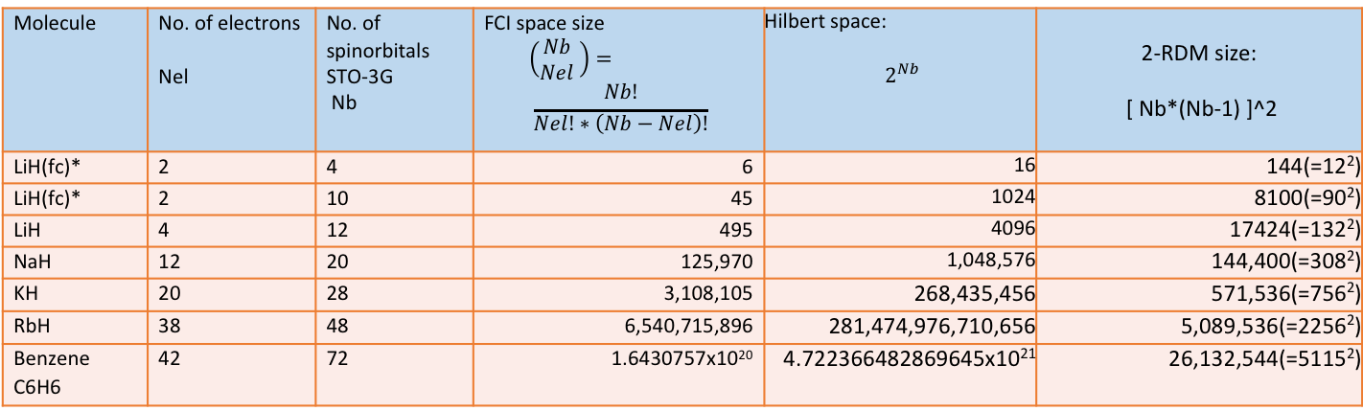
Computational cost and problem size
Coupled –cluster (CC) methods ➔ gold standard method in quantum chemistry
accuracy: HF < MPn < CC < Full Configuration Interaction (FCI)
Variational principle: wavefunction (or density matrix) until energy at minimum
Molecule | No. of electrons Nel | No. of spinorbitals STO-3G Nb | FCI space size $$\left(\begin{matrix}Nb \\ Nel\end{matrix} \right)= \\ \frac{Nb!}{Nel!∗\left(Nb−Nel\right)!}$$ | Hilbert space: $$2^{Nb}$$ | 2-RDM size: [ Nb*(Nb-1) ]^2
LiH(fc)* | 2 | 4 | 6 | 16 | 144(=12²)
LiH(fc)* | 2 | 10 | 45 | 1024 | 8100(=90²)
LiH | 4 | 12 | 495 | 4096 | 17424(=132²)
NaH | 12 | 20 | 125,970 | 1,048,576 | 144,400(=308²)
KH | 20 | 28 | 3,108,105 | 268,435,456 | 571,536(=756²)
RbH | 38 | 48 | 6,540,715,896 | 281,474,976,710,656 | 5,089,536(=2256²)
Benzene C6H6 | 42 | 72 | 1.6430757x10²⁰ | 4.722366482869645x10²¹ | 26,132,544(=5115²)
Energy depends only on 2RDM
But there are also DFT methods ➔ not much done so far.

Slide 16
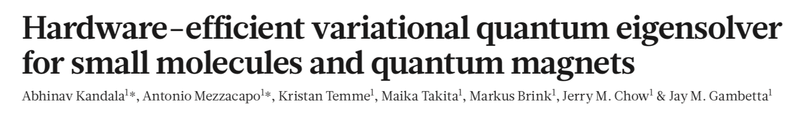
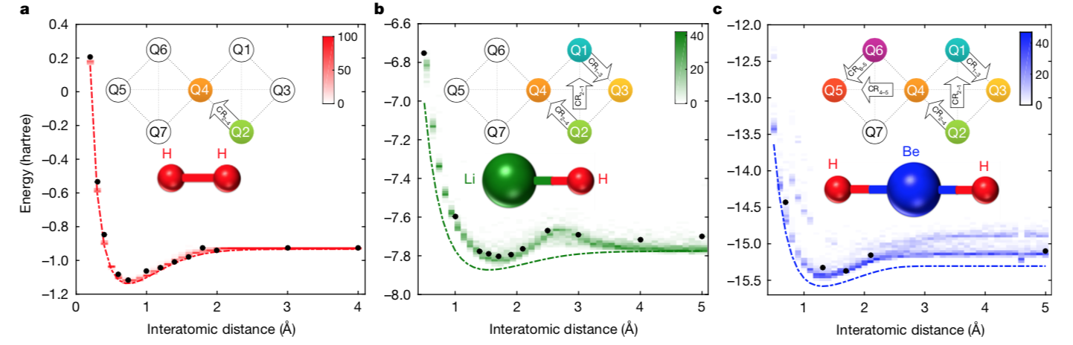
IBM group simulations (superconducting qubits)
Nature, 549, 242 (2017)

Slide 17
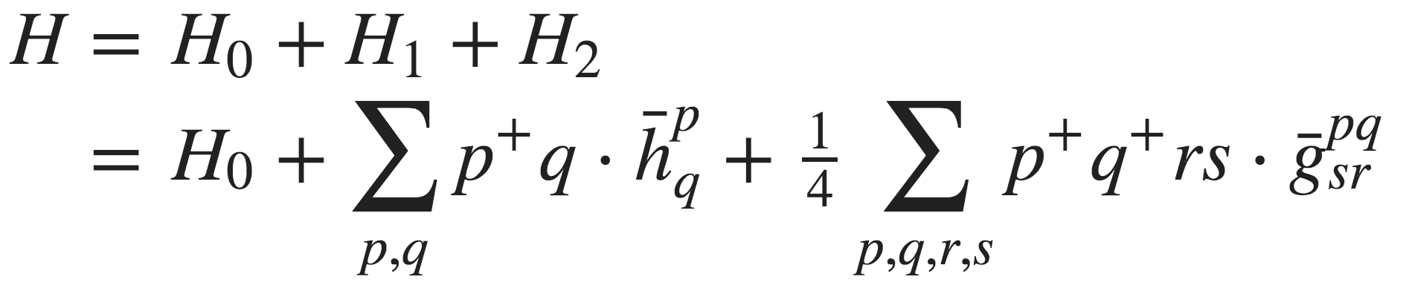
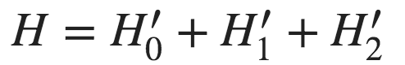
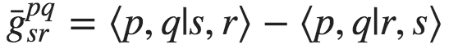
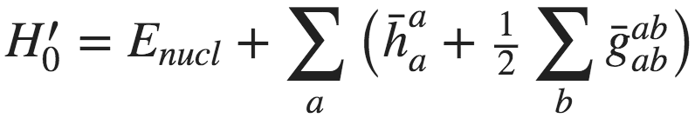
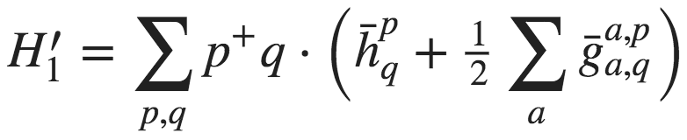
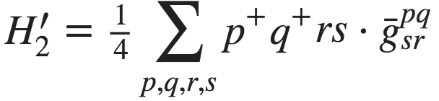
Build Hamiltonian in 2nd Quantization All electrons vs Frozen Core
All electrons case:
Frozen core approximation:
Valence electrons → delocalized
(active) chemical bonding
dynamical correlation
Core electrons → localized near nucleus,
(frozen) not involved in chemistry,
mean field approximation
excitations
↑↓
H0 - nuclear repulsion (0-electrons)
h^{p}_{q} - core Hamiltonian (1-electron): (kinetic energy + interaction with core ions)
g^{pq}_{rs} - antisymmetrized 2-electron repulsion integrals
↑↓
↑↓
↑↓
↑↓
↑↓
↑↓
p,q,r,s - runs over all spin-orbitals
Valence electrons
mean field interaction
with frozen electrons
(new term)
core electrons
p,q,r,s - active spin-orbitals
a,b - inactive spin-orbitals of frozen core

Slide 18
Alkali metal hydrides
Space size: 4-spinorbitals
Spin notation: |↑↑,↓↓>
spin
0
|0000>
“0” electrons:
“0” electrons: |0000>
”1” electron: |0010>
“2” electrons: |1010>
“3” electrons: |1011>
“4” electrons: |1111>
1/2
{
|10,00>
|01,00>
”1” electron:
1/2
{
|00,10>
|00,01>
1
|11,00>
“2” electrons:
{
|10,10>
0 + 1
|10,01>
|01,10>
|01,01>
1
|00,11>
1/2
{
|01,11>
|10,11>
{
|11,10>
“3” electrons:
1/2
|11,01>
“4” electrons:
0
|11,11>
0.9877 |1010> - 0.1218*|0101> +0.0695*( |1001> +|0110>)

Slide 19
Variational Quantum Eigensolver (VQE)
Variational principle → find quantum state by minimization of energy:
Trial function (ansatz):
← Unknown parameters (to be changed)
← Fixed basis set ( NOT to be changed)
← Overlap matrix
← Orthonormality of basis set (=orthogonal, normalized)
Normalization of requirement:
Rotation of the N-dimensional sphere
of radius =1
Trial function (ansatz)

Slide 20
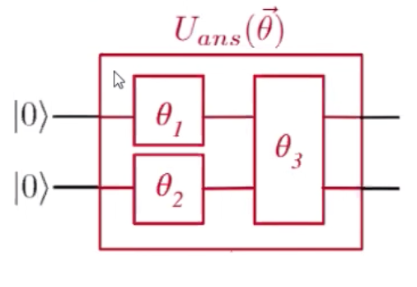
Variational Quantum Eigensolver (VQE)
Trial state is prepared by parametrized quantum circuit
Start with Hartree-Fock as initial state
Act on the state with circuit parametrized with angles
Prepare trial state:

Slide 21
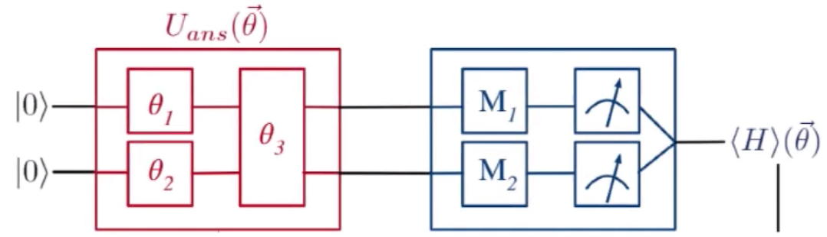
Variational Quantum Eigensolver (VQE)
2. Measure state with quantum circuit
Create circuit for each term in the Hamiltonian
Sample circuit repeatedly to determine expectation value for energy
Prepare trial state:

Slide 22
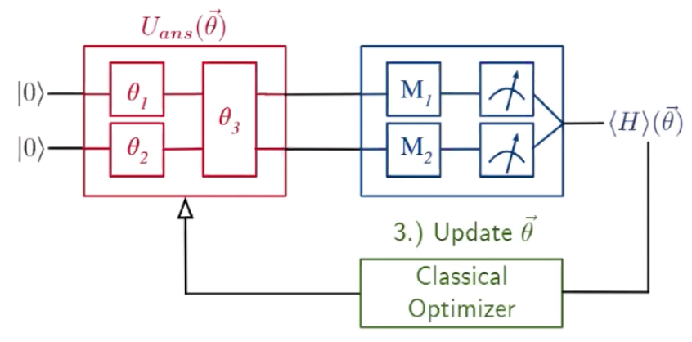
Variational Quantum Eigensolver (VQE)
3. Feed the energy and angles into classical optimization loop
Take energy and angles
Use your favorite optimization step
Determine new angles
Repeat steps 1-3 until minimum is found
Prepare trial state:

Slide 23
Workflow overview
Generate molecular data (quantum chemistry package)
Psi4, FySCF → Hartre-Fock, integrals, orbitals
Generate Fermionic Hamiltonian
OpenFermion
Jordan Wigner or Bravyi Kitaev of molecular Hamiltonian to qubits
Preparation of Ansatz circuit for
Measurements of ansatz circuit over many samples → energy
Adjust parameters and repeat

Slide 24
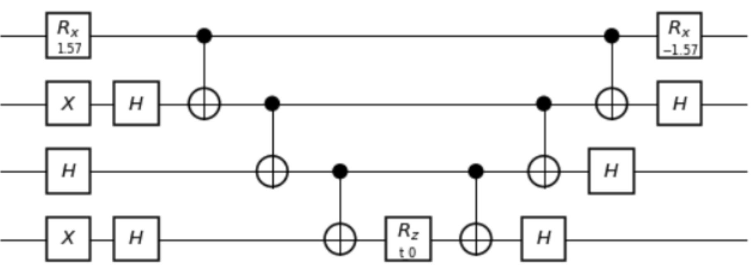
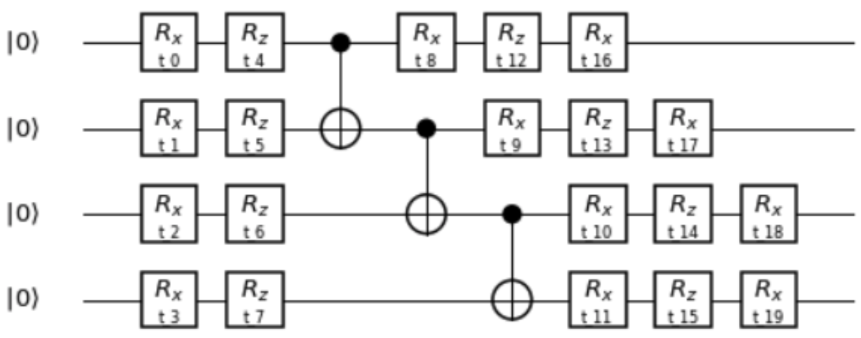
Trial wavefunction (Ansatz)
Hydrogen-like molecules: LiH, NaH, KH, RbH with STO-3G basis
Adjustable list of active orbitals (1 active orbital= 1 qubit)
Frozen core Hamiltonian with 2 electrons, 4 orbital
Ansatz:
UCC
HWE (HardWare Efficient)
J. Romero, R. Babbush, J. R. McClean, C. Hempel, P. Love, and A. Aspuru-Guzik. Quantum Science and Technology, 4, 2018.
A. Kandala, A. Mezzacapo, K.Temme, M. Takita, M. Brink, J. M. Chow, J.M. Gambetta,
Nature, 549, 242 (2017)

Slide 25
Trial wavefunction (Ansatz)
Unitary Coupled Cluster Ansatz (UCC)
primitive CC
one parameter (small search space)
not accurate (double excitation)
preserve symmetry (N_{electrons})
J. Romero, R. Babbush, J. R. McClean, C. Hempel, P. Love, and A. Aspuru-Guzik. Quantum Science and Technology, 4, 2018.
Hardware Efficient Ansatz (HWE)
“brute force”
can map to exact FCI energy
20 parameters (large search space)
mixes states with different electron number
A. Kandala, A. Mezzacapo, K.Temme, M. Takita, M. Brink, J. M. Chow, J.M. Gambetta, Nature, 549, 242 (2017)

Slide 26
Trial wavefunction (Ansatz)
Energy (Eh)
“0” electrons: |0000>
”1” electron: |0010>
“2” electrons: |1010>
“3” electrons: |1011>
“4” electrons: |1111>
modification of UCC
constrained VQE optimization
simulated results for KH
spectroscopy
8-CNOTs
21-instructions
3 – parameters
|1111>
parameters (Rz)
|0101>
?
?
|0111>,|1101>
?
|0000>
?
|0100> , |0001>
|1011> , |1110>
Ux
U
(|1001>+|0110>)
(initial state prep)
(ansatz optimization circuit)
(|1001>-|0110>), |1100>, |0011>
Ux(q0,q2): |0000> → |1010>
|1000>, |0010>
U: |1010> → |1010> + c1*|0101> + c2*|1001>+….
|1010>
H2:
|FCI> = 0.9 * |1010> - 0.2*|0101>
RbH:
|FCI> = 0.9877 |1010> - 0.1218*|0101> +0.0695*( |1001> +|0110>)
KH, Bond length (Angstroom)
0.9877 |1010> - 0.1218*|0101> +0.0695*( |1001> +|0110>)
Notes:
The plot on the right side show true many-body (entangled) states. But the labels show only the leading term --- this is sufficient to identify all states.
The curves correspond to “classical” calculations whereas the “dots” to correspond “quantum” calculations. I was able to generate the quantum states using our 3-paramters ansatz and various optimization techniques. These states were optimized from various initial states and sometimes with added constraints (suchas given number of electrons). All states besides the trivial ones: |0000> and |1111> are entangled.

Slide 27
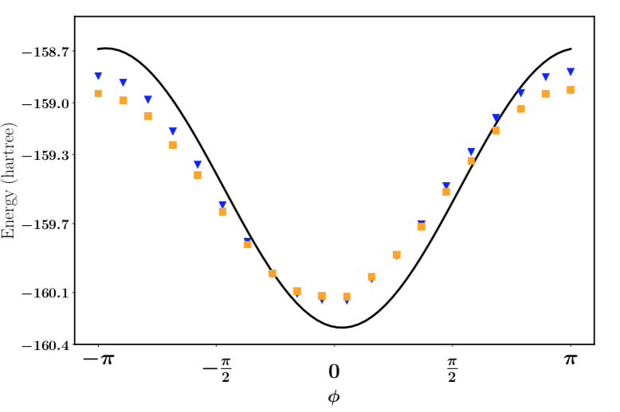
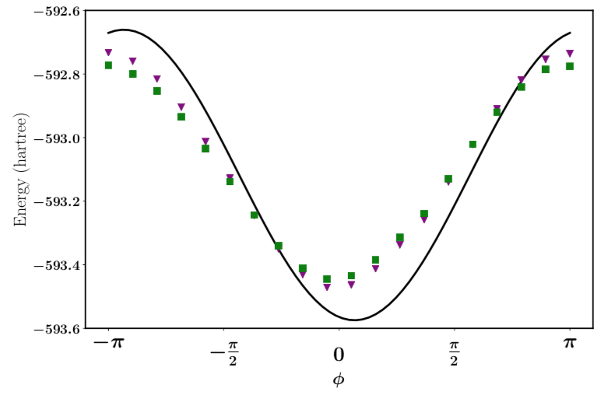
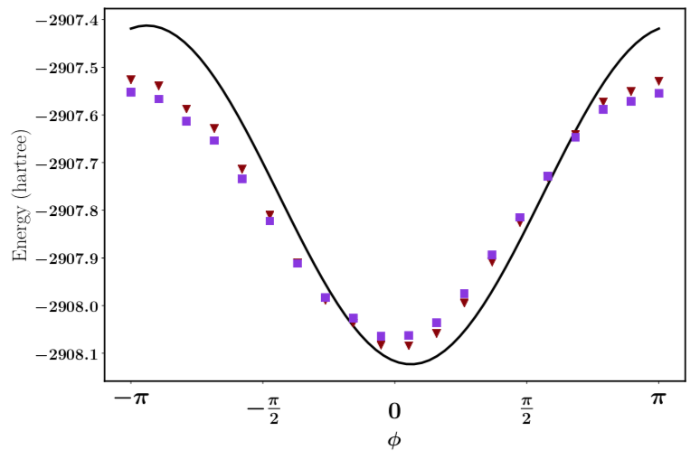
Benchmark results (ongoing)
UCC requires a single parameter for 2 electrons, 4 orbitals (scan)
Known energy➔ hardware test
NaH
KH
RbH
The dependence of the energy as a function of the variational parameter φ for the reduced UCC ansatz on the 20-qubit IBM Tokyo QPU.

Slide 28
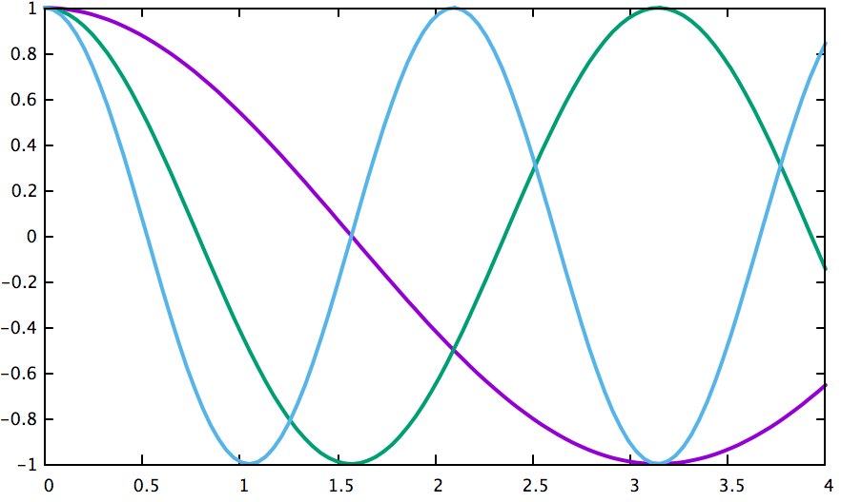
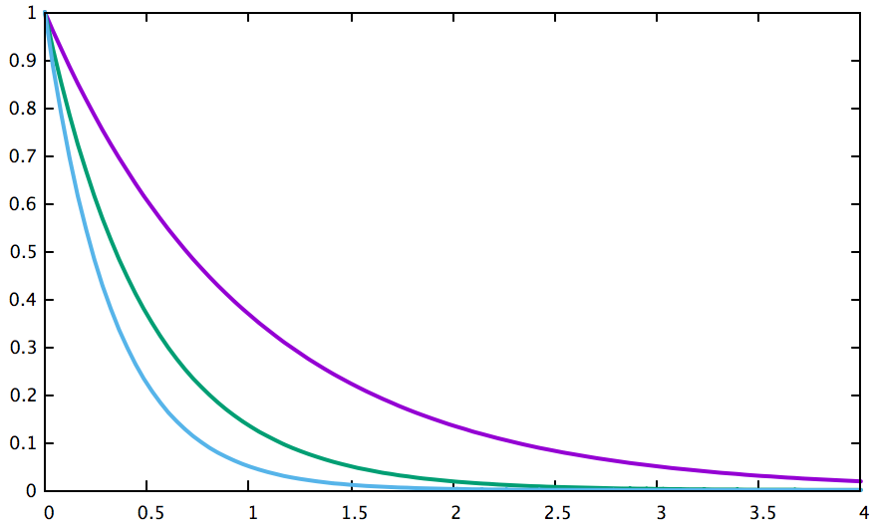
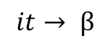
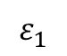
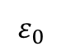
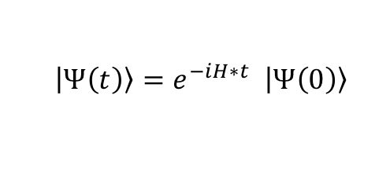














Quantum Imaginary Time Evolution
Conventional (real-time) evolution of quantum state
c(t)
$$\left|\left.Ψ\left(t\right)\right\rangle \right.=e^{−iH∗t} \left|\left.Ψ\left(0\right)\right\rangle \right.$$
← $\left|\left.Ψ\left(0\right)\right\rangle \right.$is initial state
$$ε_{0}$$
$$ε_{1}$$
$$ε_{2}$$
$$\left|\left.\left.Ψ(t\right)\right\rangle =c_{0}(t)\left.|0\right\rangle +c_{1}(t)\left.|1\right\rangle + c_{2}(t)\left.|2\right\rangle + ...\right.$$
Where $\left.|k\right\rangle$ are unknown eigenstates:$\left. H|k\right\rangle =ε_{k}\left.|k\right\rangle$
$\left[\begin{matrix}c_{0}\left(t\right) \\ c_{1}\left(t\right) \\ c_{2}\left(t\right)\end{matrix}\right] =\left(\begin{matrix}e^{−iε_{0}t} & & \\ & e^{−iε_{1}t} & \\ & & e^{−iε_{2}t}\end{matrix}\right) ∗\left[\begin{matrix}\left.c_{0}(0\right) \\ c_{1}\left(0\right) \\ c_{2}\left(0\right)\end{matrix}\right]$= $\left[\begin{matrix}c_{0}\left(0\right)∗e^{−iε_{0}t} \\ c_{1}\left(0\right) ∗e^{−iε_{1}t} \\ c_{2}\left(0\right)∗e^{−iε_{2}t}\end{matrix}\right]$
time
Imaginary time evolution of quantum state - Quantum Monte Carlo
- Diffusion Monte Carlo
unitary
${|ε}_{0}|<{|ε}_{1}|<$ ${|ε}_{2}|$
$$\left|\left.Ψ\left(t\right)\right\rangle \right.=e^{−βH} \left|\left.Ψ\left(0\right)\right\rangle \right.$$
← $\left|\left.Ψ\left(0\right)\right\rangle \right.$is arbitrary, random state
c(t)
$$it→ β$$
← Swap real time with imaginary
nonunitary
$$ε_{0}$$
$$\left[\begin{matrix}c_{0}\left(t\right) \\ c_{1}\left(t\right) \\ c_{2}\left(t\right)\end{matrix}\right] =\left(\begin{matrix}e^{− {βε}_{0}} & & \\ & e^{−βε_{1}} & \\ & & e^{−βε_{2}}\end{matrix}\right) ∗\left[\begin{matrix}c_{0}\left(0\right) \\ c_{1}\left(0\right) \\ c_{2}\left(0\right)\end{matrix}\right]=\left[\begin{matrix}c_{0}\left(0\right)∗e^{− {βε}_{0}} \\ c_{1}\left(0\right) ∗e^{− {βε}_{1}} \\ c_{2}\left(0\right)∗e^{− {βε}_{2}}\end{matrix}\right]$$
$$ε_{1}$$
$$ε_{2}$$
$$\lim_{t→∞}\left|\left.Ψ\left(t\right)\right\rangle \right.= \sim \left|\left.0\right\rangle \right.$$
if
$$c_{0}\left(0\right)≠0$$
Similar concept:
Lanczos/Krylov space
Ref: Motta, Chan. et. al. Nature Phys. 16,205 (2020)
time

Slide 29











Quantum Imaginary Time
$$\left|\left.1\right\rangle \right.$$
t₀
Δ
Ψ(0)
Δ₀
t₁
Problem: imaginary time propagation is non-unitary
Ψ’
Ψ
solution: map non-unitary update onto ’closest’ unitary one Motta, Chan. et. al. Nature Phys. 16,205 (2020)
$$\left|\left.0\right\rangle \right.$$
t₂
$$\left|\left.Ψ′\right\rangle \right.=e^{−∆t∗H} \left|\left.\left.Ψ(0\right)\right\rangle \right.$$
← non-unitary update, H known
$$\left|\left.Ψ\right\rangle \right.=e^{−i∆t∗A} \left|\left.\left.Ψ(0\right)\right\rangle \right.$$
← unitary update, A unknown
Update vectors
$$\left|\left.∆\right\rangle \right.=\left|\left.Ψ\right\rangle \right.−\left|\left.\left.Ψ(0\right)\right\rangle \right.$$
$$\left|\left.∆′\right\rangle \right.=\left|\left.Ψ′\right\rangle \right.−\left|\left.\left.Ψ(0\right)\right\rangle \right.$$
Minimize $\left|\left.∆′\right\rangle −\left|\left.∆\right\rangle \right.\right.$ subject to unknown $A=\sum_{k}{a_{k}P_{k}}$
$$\min_{A}\left\|\left|\left.∆′\right\rangle −\left|\left.∆\right\rangle \right.\right.\right\|$$
← Quadratic with respect to parameters a
$$\left|\left.1\right\rangle \right.$$
Generalization to excited states: replace H with (H-I*E)² to find state nearest to E
t₀
t₁
t₂
$$\left|\left.0\right\rangle \right.$$

Slide 30




Extension of Quantum Imaginary Time Evol.
c(t)
Excited states:
replace H with H’= (H-E*I)²
eigenvectors preserved because [H’,H]=0
eigenvalues modified: $ε_{k}^{′}={\left(ε_{k}−E\right)}^{2}$
QITE will converge to state |k> whose eigenvalue $ε_{k}$ closest to E
Beyond Fermionic systems
expand arbitrary H in terms of Pauli operators
$$ε_{0}$$
$$ε_{1}$$
$$ε_{2}$$
time

Slide 31
Pauli Operator Expansion

Slide 32






Pauli Operator Expansion of Hermitian Matrices
SU(2) generators {X,Y,Z} form a basis set for 2x2 unitary matrices
{I,X,Y,Z} form a basis for 2x2 Hermitian matrices
LiH
SU(N) generators form a basis set for N x N unitary matrices overall (N² -1) traceless generators
Example SU(4), Gell-man matrices (easy to generalize for any N):
Adding 4x4 Identity suffice to allow generate all Hermitian matrices, but not very convenient
Ideally, we need to employ 2x2 Pauli matrices and tensor products

Slide 33


Pauli Operator Expansion
LiH

Slide 34

















Example: 4x4 case
(I + X +Y +Z) ^2 = I + IX + IY +IZ + XI +XX +XY +XZ + YI + YX + YY + YZ + ZI +ZX +ZY +ZZ
I=$\left(\begin{matrix}\begin{matrix}1 & \\ & 1\end{matrix} & \begin{matrix} & \\ & \end{matrix} \\ \begin{matrix} & \\ & \end{matrix} & \begin{matrix}1 & \\ & 1\end{matrix}\end{matrix}\right)$
IY=$\left(\begin{matrix}\begin{matrix} & −i \\ i & \end{matrix} & \\ \begin{matrix} & \\ & \end{matrix} & \begin{matrix} & −i \\ i & \end{matrix}\end{matrix}\right)$
IX=$\left(\begin{matrix}\begin{matrix} & 1 \\ 1 & \end{matrix} & \\ \begin{matrix} & \\ & \end{matrix} & \begin{matrix} & 1 \\ 1 & \end{matrix}\end{matrix}\right)$
IZ=$\left(\begin{matrix}\begin{matrix} 1 & \\ & −1 \end{matrix} & \\ \begin{matrix} & \\ & \end{matrix} & \begin{matrix} & \\ \begin{aligned} 1 \\ \end{aligned} & −1\end{matrix}\end{matrix}\right)$
$$XI=\left(\begin{matrix} & & 1 & \\ & & & 1 \\ 1 & & & \\ & 1 & & \end{matrix}\right)$$
$$XX=\left(\begin{matrix} & & & 1 \\ & & 1 & \\ & 1 & & \\ 1 & & & \end{matrix}\right)$$
$$XY=\left(\begin{matrix} & & & −i \\ & & i & \\ & −i & & \\ i & & & \end{matrix}\right)$$
$$XZ=\left(\begin{matrix} & & 1 & \\ & & & −1 \\ 1 & & & \\ & 1 & & \end{matrix}\right)$$
$$YI=\left(\begin{matrix} & & −i & \\ & & & −i \\ i & & & \\ & i & & \end{matrix}\right)$$
$$YZ=\left(\begin{matrix} & & −i & \\ & & & i \\ i & & & \\ & −i & & \end{matrix}\right)$$
$$YX=\left(\begin{matrix} & & & −i \\ & & −i & \\ & i & & \\ i & & & \end{matrix}\right)$$
$$YY=\left(\begin{matrix} & & & −1 \\ & & 1 & \\ & 1 & & \\ −1 & & & \end{matrix}\right)$$
$$ZI=\left(\begin{matrix}1 & & & \\ & 1 & & \\ & & −1 & \\ & & & −1\end{matrix}\right)$$
$$ZX=\left( \begin{matrix} & 1 & & \\ 1 & & & \\ & & & −1 \\ & & −1 & \end{matrix}\right)$$
$$ZY=\left(\begin{matrix} & −i & & \\ i & & & \\ & & & i \\ & & −i & \end{matrix}\right)$$
$$ZZ=\left(\begin{matrix}1 & & & \\ & −1 & & \\ & & −1 & \\ & & & 1\end{matrix}\right)$$

Slide 35

General case
Prescription for N where N=2^{Nq}:
$H= \sum_{k }^{ }{C_{k}∗{\hat{P}}_{k}}$
where ${\hat{P}}_{k}∈{\{I,X,Y,Z\}}^{⊗Nq}$
and $C_{k}=Tr[H∗{\hat{P}}_{k}]/ 2^{Nq}$
orthogonality: $Tr[{\hat{P}}_{k}∗{\hat{P}}_{l}]/ 2^{Nq}$ =δ_{k,l}
Some properties
- for diagonal matrices X,Y don’t contribute, only ${\{I, Z\}}^{⊗Nq}$ suffice
- for H real symmetric only even ‘powers’ of Y strings appear:
example for Nq=4 : IXYY, XYZY, YYIZ, YYYY, etc

Slide 36




Examples
Benzene Hamiltonian:
1st excited state 8x8 block
- Harmonic oscillator 1D
Real space discretization, 128 mesh points
Hamiltonian matrix: 16,384 matrix elements
7 qubits
~300 Pauli terms,
$H\left(i,j\right)=\left\{\begin{aligned}\frac{1}{mΔx^{2}}+V\left(x_{i}\right), \text{for} i=j \\ \frac{−1}{2mΔx^{2}}, \text{for} |i−j|=1 \\ 0, \text{for} \left|i−j\right|>1\end{aligned}\right.$

Slide 37
Thank you

